Slide 1
Breast Cancer Prediction
Tanay Ganeriwal, Bharath Jagini, Premchand Jayachandran, Tejas Mahajan

Slide 2
Introduction
Objective: The objective is to develop a machine learning model to predict based on the inputs given whether the cell is malignant or benign. For each cell nucleus, there are 10 inputs computed and provided in the dataset.
Challenge: To develop a model which can predict the cancer faster with it also being very accurate, thus enabling to initiate faster treatments and resulting in less casualty.

Slide 3
Data Exploration
The dataset is computed from digitized image of a fine needle aspirate (FDA) of a breast mass which describes the characteristics of a cell nuclei present in the image.
It consists of details such as :
ID Number
Diagnosis(target)
Values generated from the cell nuclei
a) radius (mean of distances from center to points on the perimeter)
b) texture (standard deviation of gray-scale values)
c) perimeter
d) area
e) smoothness (local variation in radius lengths)
f) compactness (perimeter^2 / area - 1.0)
g) concavity (severity of concave portions of the contour)
h) concave points (number of concave portions of the contour)
i) symmetry
j) fractal dimension ("coastline approximation" - 1)
There are 10 real-valued features computed from the cell nuclei and for each of them the mean, standard error and ‘worst’(mean of largest values) are computed to form 30 features resulting in a total of 33 features

Slide 4
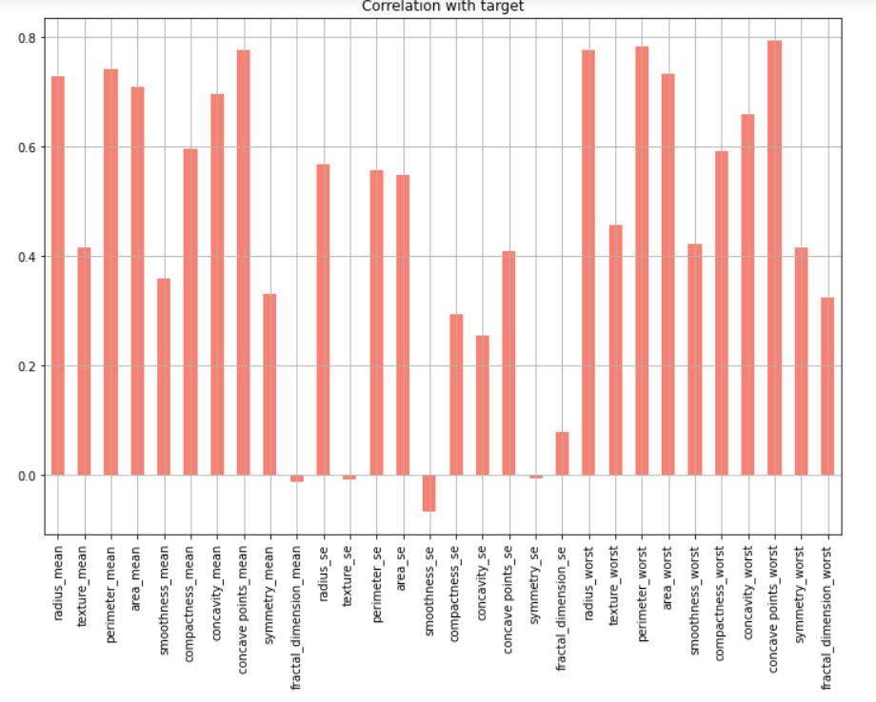
Data Visualization
Data Correlation between the features and the target

Slide 5
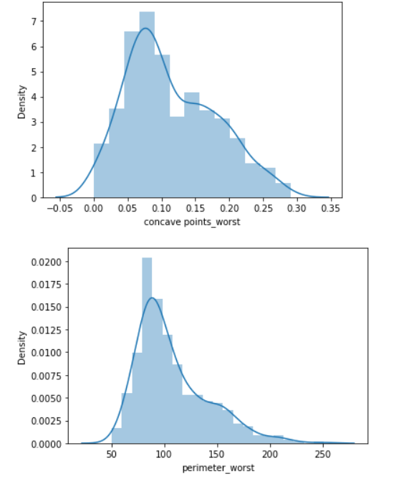
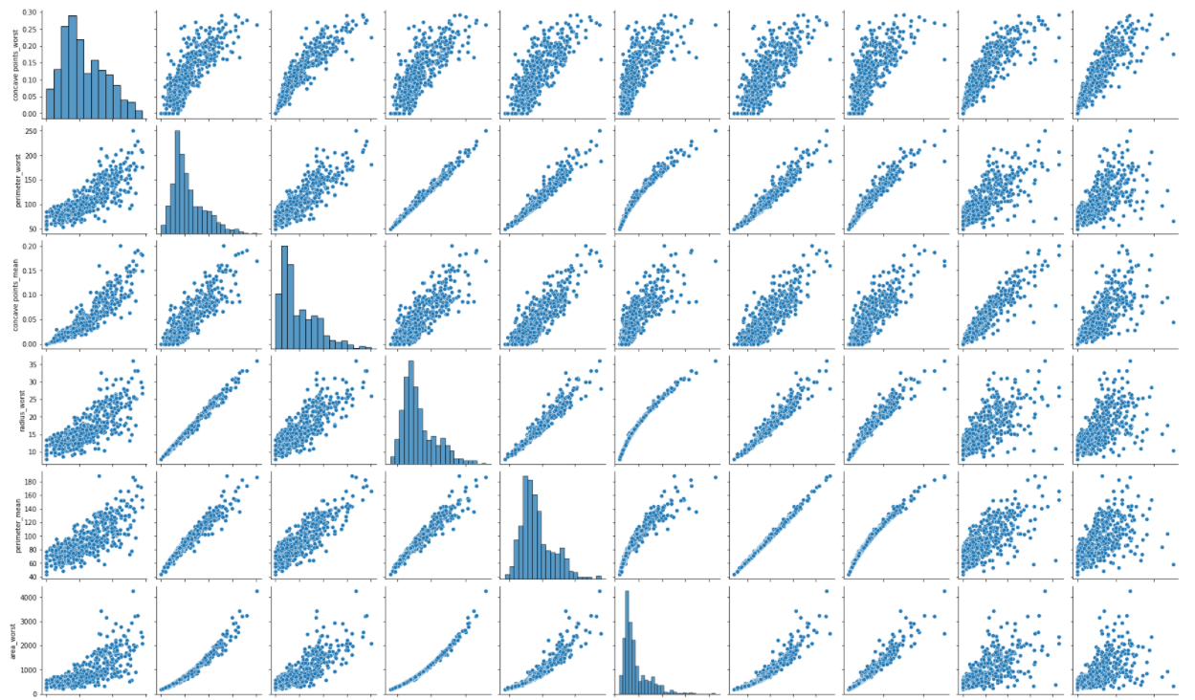
Data Visualization
Data exploration of the primary features.

Slide 6
Data Preprocessing and feature selection
The feature which has no relevant data is dropped.
The target values are converted to 0 and 1.
Dataframe is checked for null values.
Different options are tried in terms feature selection and data preprocessing like
Selecting K best features.
PCA
Selecting the top features based correlation to the target
Removing the skewness using log function.
The final model uses the features selected based on the correlation and the also the log function is used to remove skewness which improves the accuracy

Slide 7
Model Selection
Since this problem is classification problem we have selected a few machine learning algorithms to see which has the best accuracy.
Logistic Regression - Accuracy of 96%
Random Forest Classifier - Accuracy of 96%
Decision Tree Classifier - Accuracy of 94%
K neighbors Classifier - Accuracy of 96%
SVM Classifier - Accuracy of 98%
Gaussian Naive Bayes - Accuracy of 96%

Slide 8
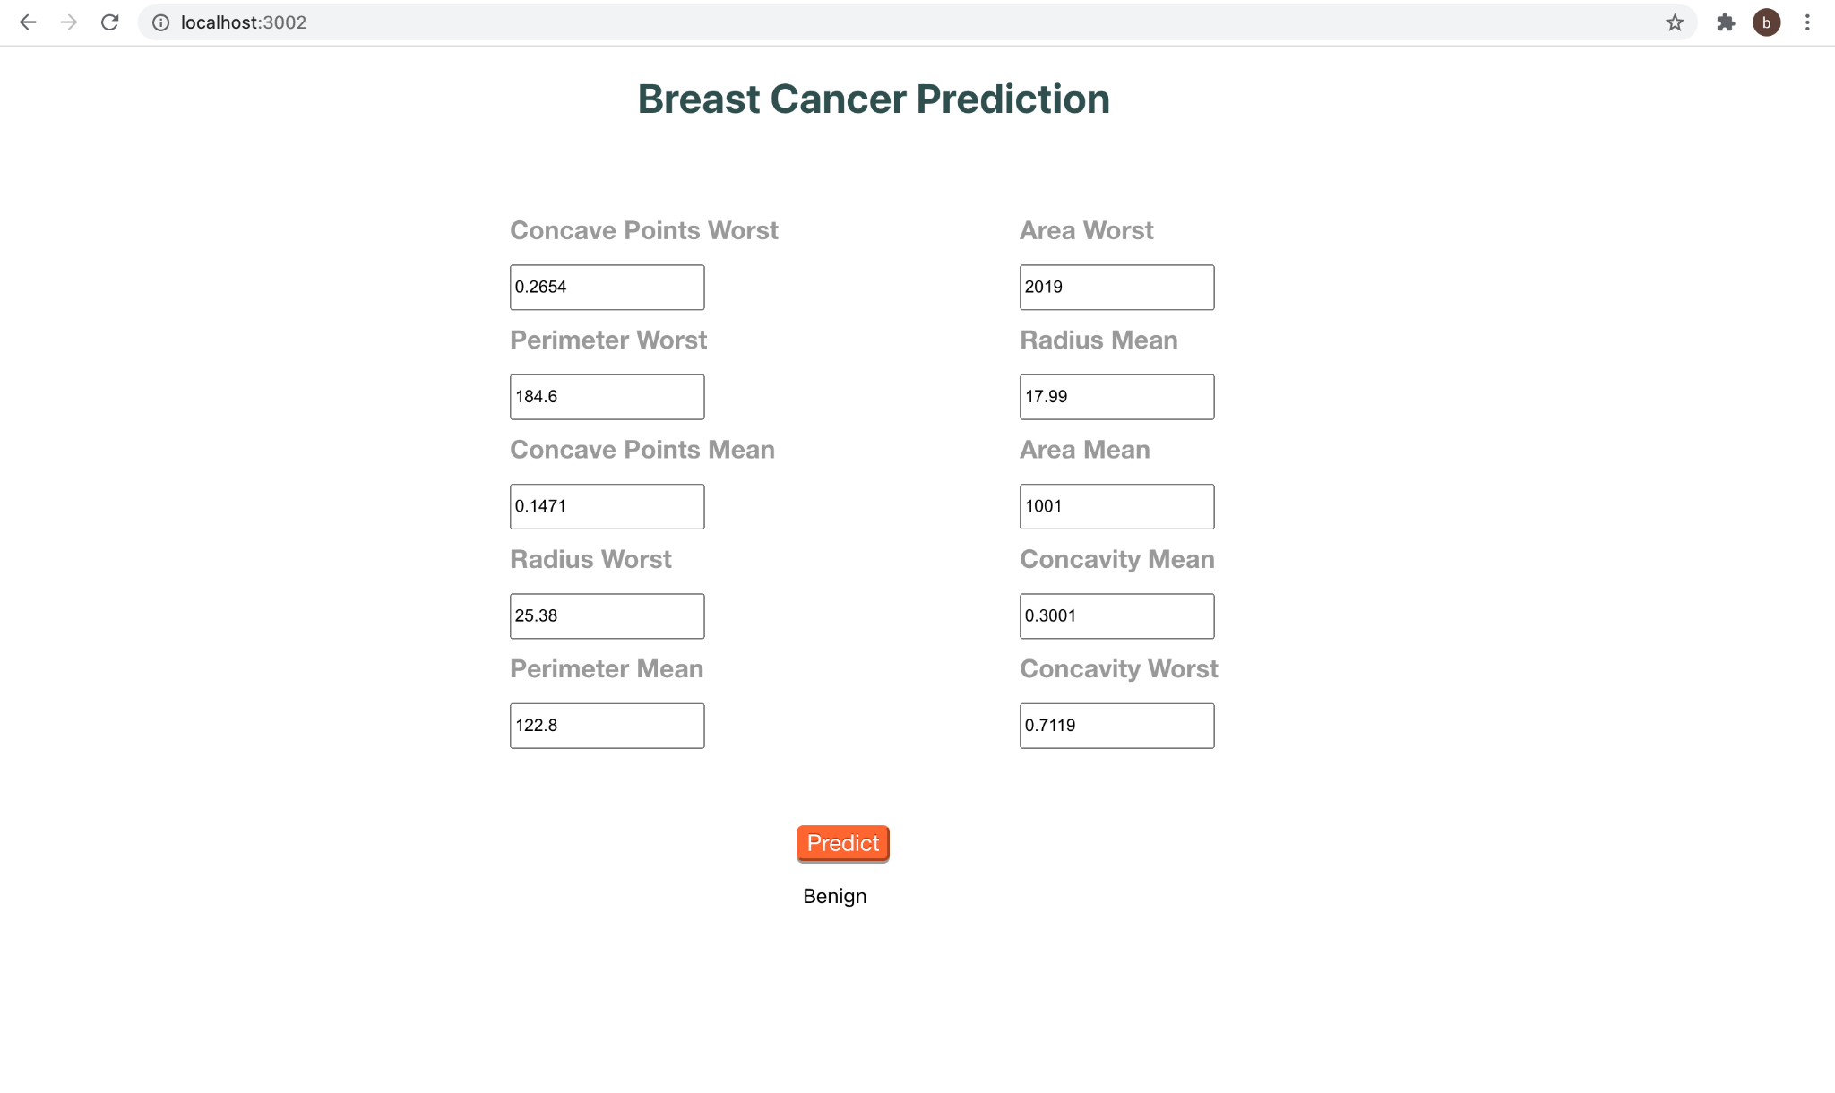
Front-End Application
An UI was developed using React as the front end and flask for writing the an API.
With this we can get the feature values as input and display the prediction(malignant or benign) as output.
This is enable easy usage of the model and help to generate the results quicker.
We can also get the results sent through a text message to the registered mobile number

Slide 9
Thank You!

